Slide 1
NARCCAP
The Experimental Climate Prediction Center - Regional Spectral Model
(ECPC-RSM)
Ana Nunes¹ and John Roads^{2*}
¹IGEO, UFRJ, Rio de Janeiro, Brazil
²ECPC,SIO, UCSD, California, USA
^{(*)} Deceased

Slide 2
Experimental Climate Prediction Center (ECPC) Regional Spectral Model (RSM)
NARCCAP Configuration
Hydrostatic, Primitive Equations
(RSM; Juang et al. 1997)
50-km resolution,
28-vertical layers
Noah
Land-Surface Model (Ek et al., 2003; Mitchell et al. 2004);
4-soil layers
Simplified Arakawa-Schubert cumulus convection scheme (SAS; Hong and Pan 1998)
Scale-Selective Bias Correction(SSBC; Kanamaru and Kanamitsu 2007)

Slide 3
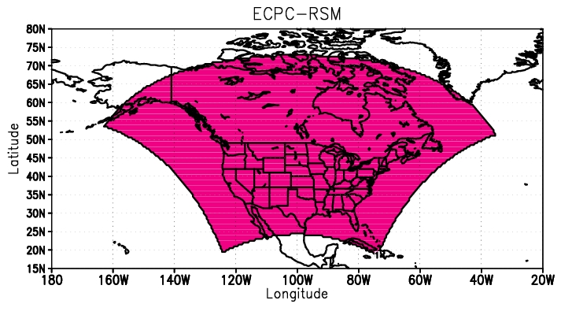
ECP2-RSM Domain
Observational (NCEP R2) Forcing & AOGCM-Driven
181x156
Notes:
The buffer zone has been removed from this plot.

Slide 4
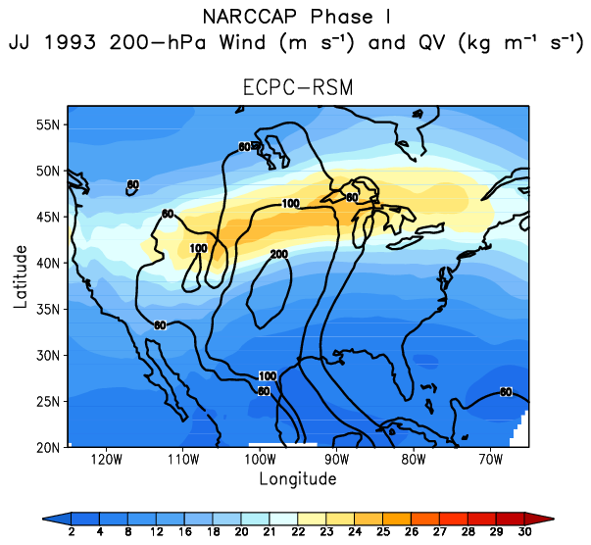
NCEP-R2-Driven Runs
Improving large-scale features in the regional domain
The NARCCAP ECP2-RSM has a modified spectral nudging and larger horizontal domain in comparison to the NARCCAP ECPC-RSM (first realization).
Phase I: Observational forcing [0 UTC 1 Jan 1979 – 0 UTC 01Jan 2005].
ECPC-RSM
ECP2-RSM
ECP2-RSM shows more realistic moisture transport from the Gulf of Mexico, and displays more robust upper-level jet.
ECP2 has better agreement with observations.

Slide 5
ECP2-RSM AOGCM-Driven Runs
Phase II
ECP2-RSM is scheduled to use initial and boundary conditions from GFDL CM2.1 and HADCM3. SRES A2 forces both global and regional models future projections.
GFDL CM2.1-driven runs:
Present climate [1968-2000]: The ECP2-RSM precipitation and 2-m temperature fields are available in NetCDF for the entire period.
(Except for Table 5, most of the table variables are now available at NARCCAP website).
Future climate [2038-2070] is running. (Done and tables are available. Thanks Seth!).
Notes:
Comments in red highlight changes from last year.

Slide 6
ECP2-RSM AOGCM-Driven Runs
Phase II
HadCM3-driven runs:
Depending upon available computer resources.
From one of the UFRJ clusters, 256 cores will be dedicated to those HadCM3-driven projections.
Initial and boundary conditions in preparation.

Slide 7
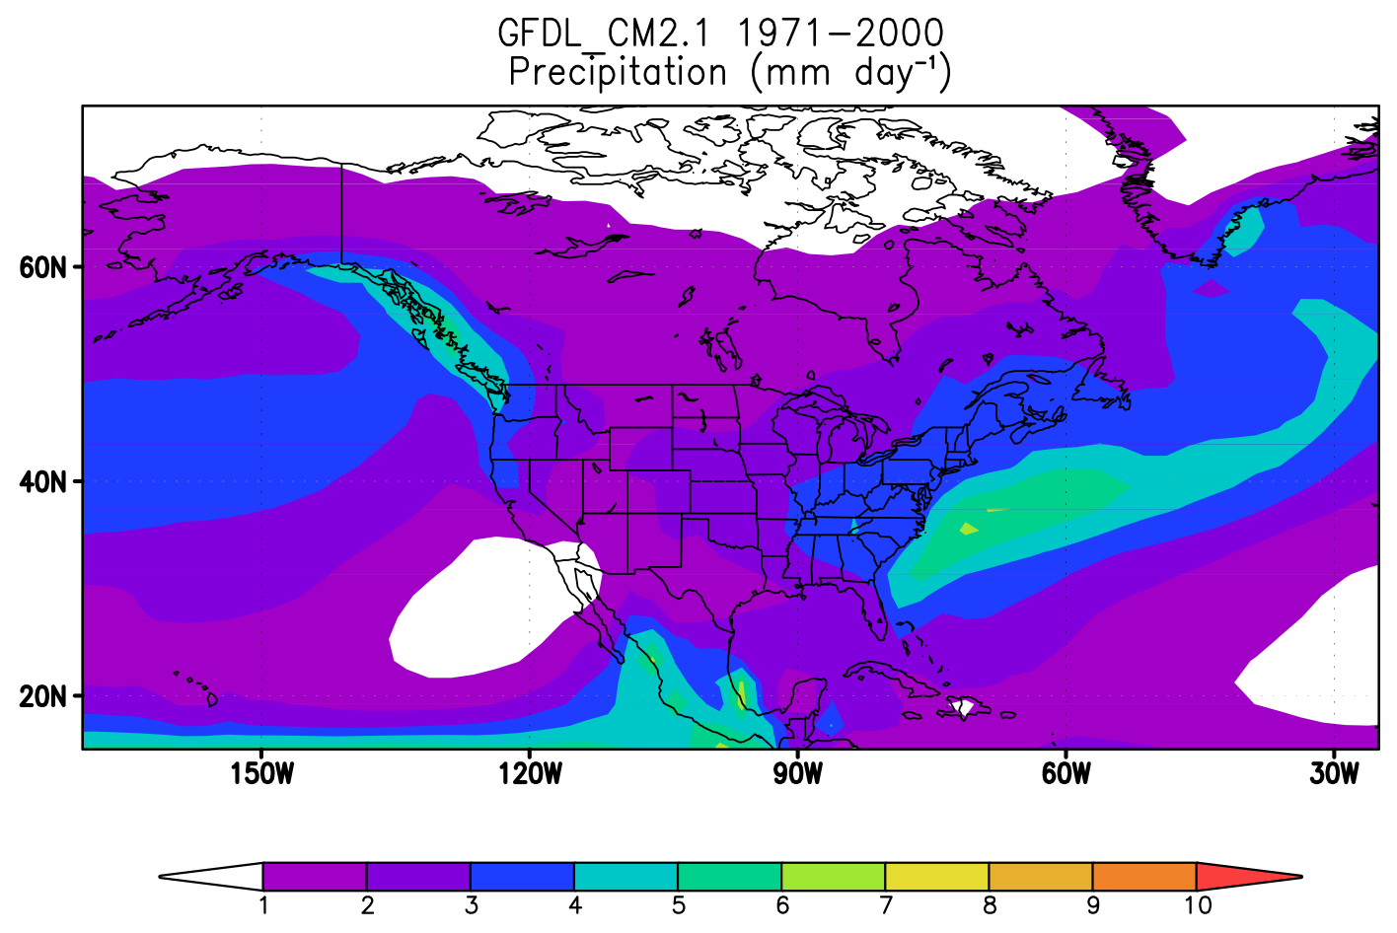
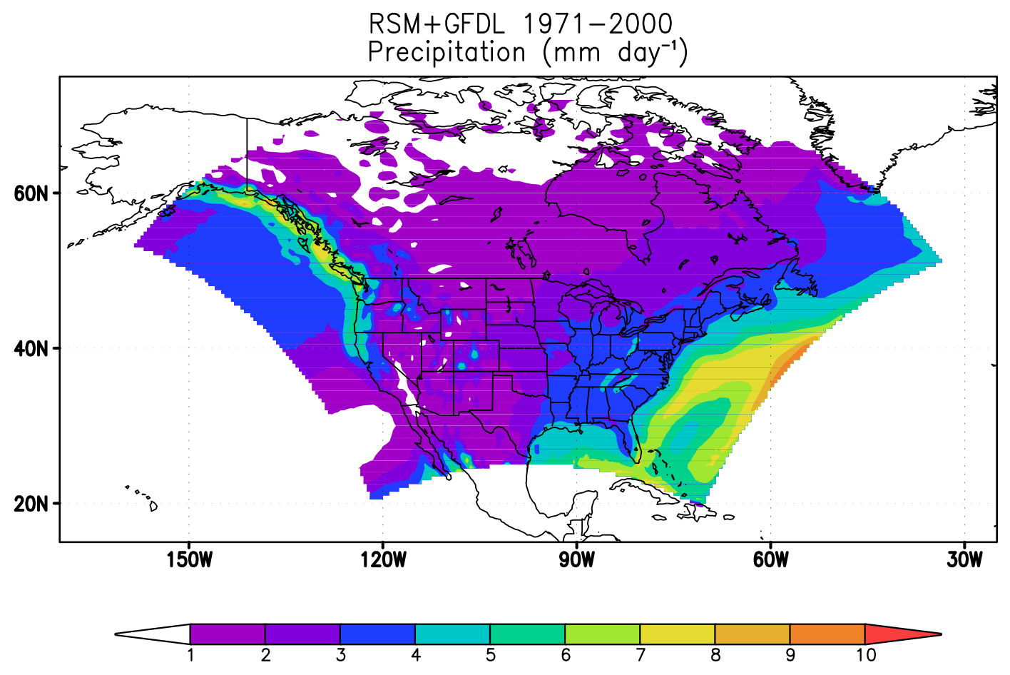
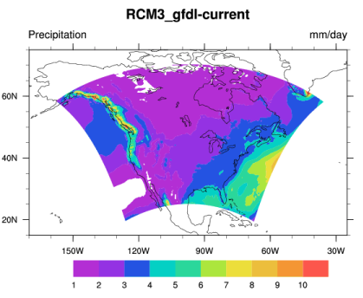
GFDL-Driven Run: 1971-2000 Precipitation
The ECP2-RSM domain covers a larger portion of the Atlantic Ocean in comparison to RegCM3.
Both RCMs shows increased precipitation over the Atlantic Ocean in comparison to the global driven model.
Notes:
ECP2-RSM driven by GFDL_CM2.1 shows excessive precipitation over the warm Atlantic Ocean in comparison to R2-driven climatology (not shown).
This cannot be correct.

Slide 8
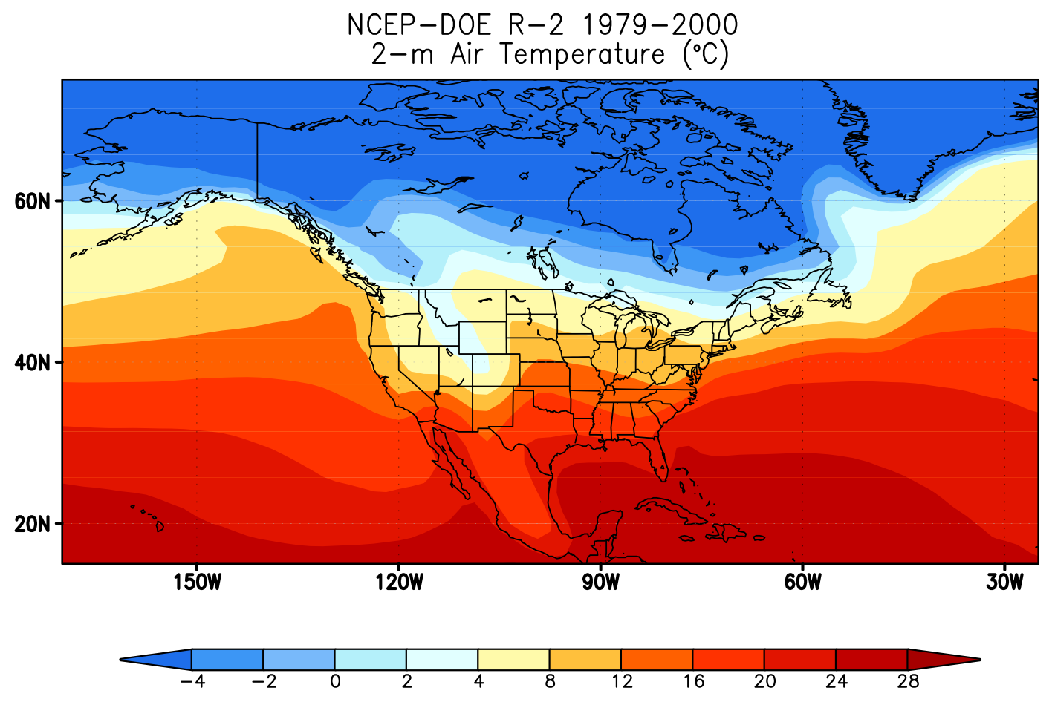
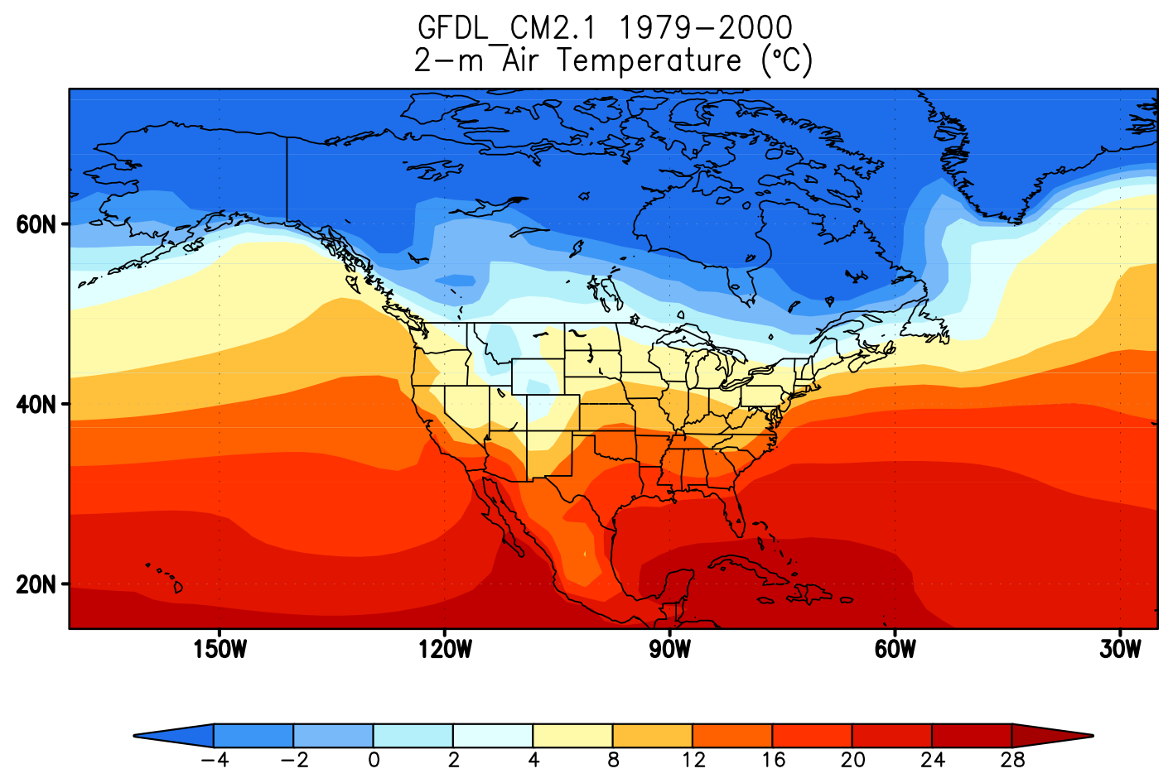
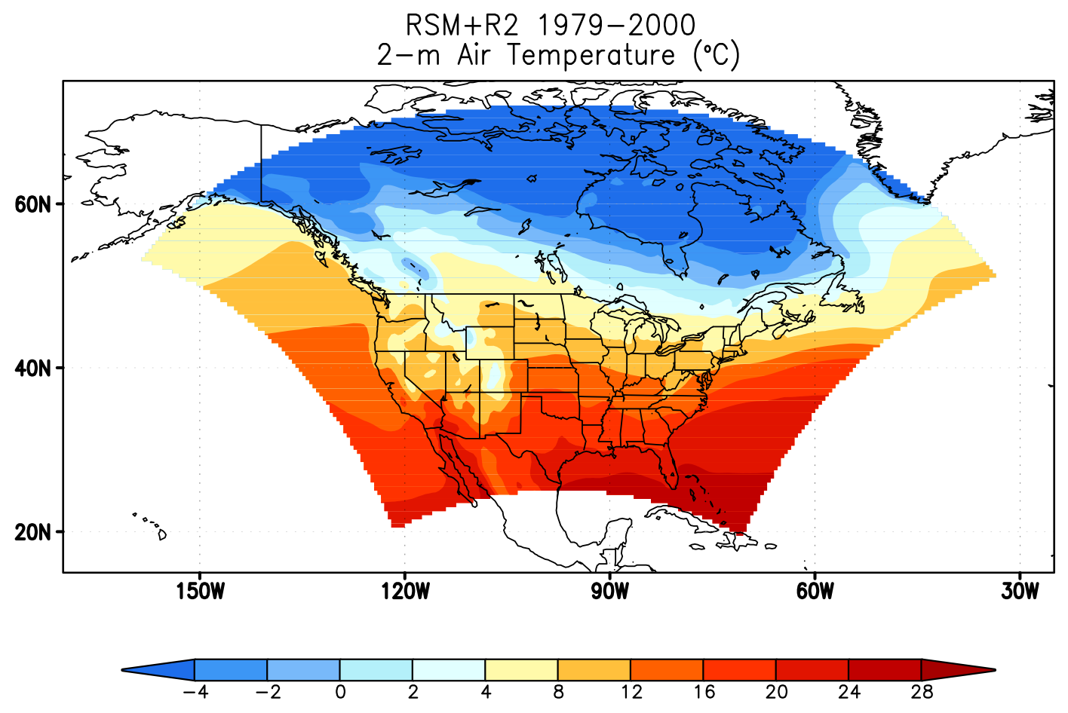
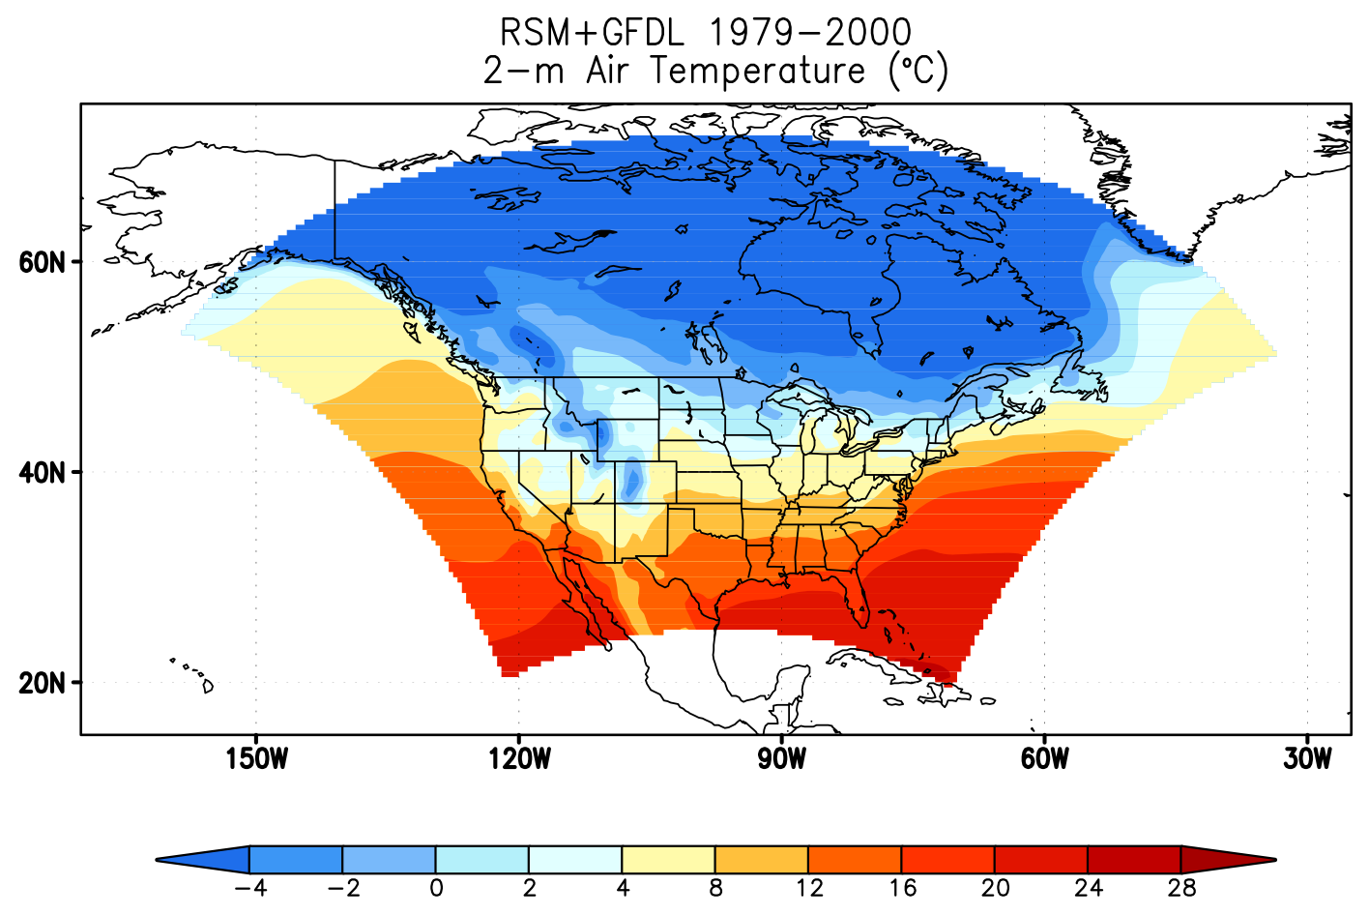
1979-2000 2-m Temperature
Notes:
ECP2 GFDL-driven is cooler than its forcing, R2 and R2-driven.

Slide 9
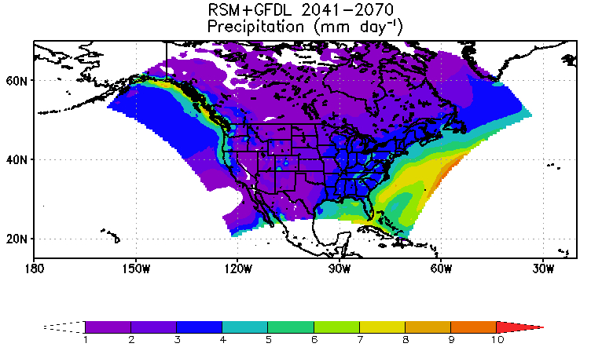
GFDL-Driven Runs: Precipitation
Increased precipitation can been found in both current and future climates over the Atlantic Ocean as a result of the GFDL SSTs.
Notes:
Resemblances are seen in the “model annual climatology” from both runs, despite enhanced seasonal differences.

Slide 10
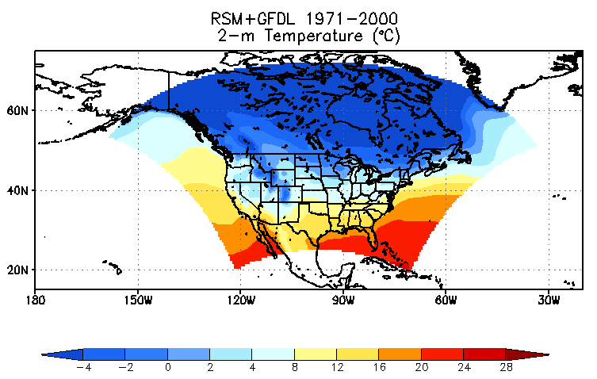
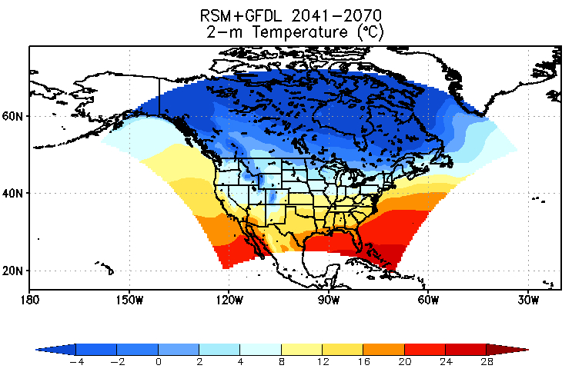
GFDL-Driven Runs: 2-m Temperature
Latitudinal differences in the temperature values can been seen, with higher values moving up north in the future climate.
Notes:
Latitudinal differences in temperature values can been seen.
Higher values moving up north in the future climate.

Slide 11
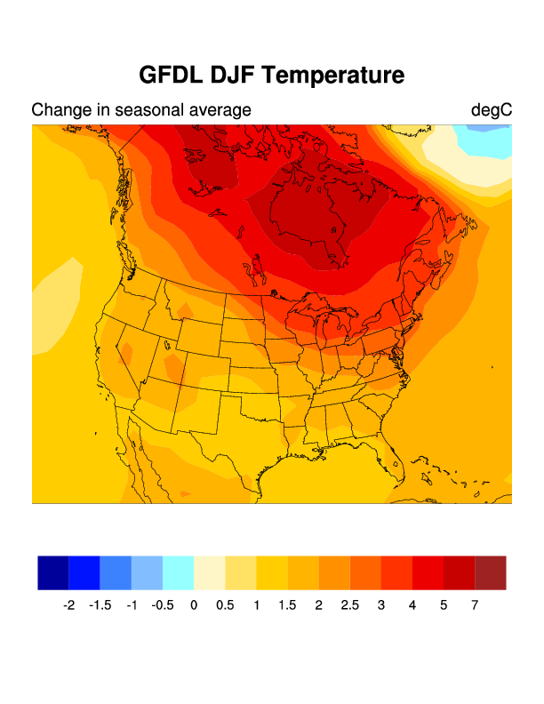
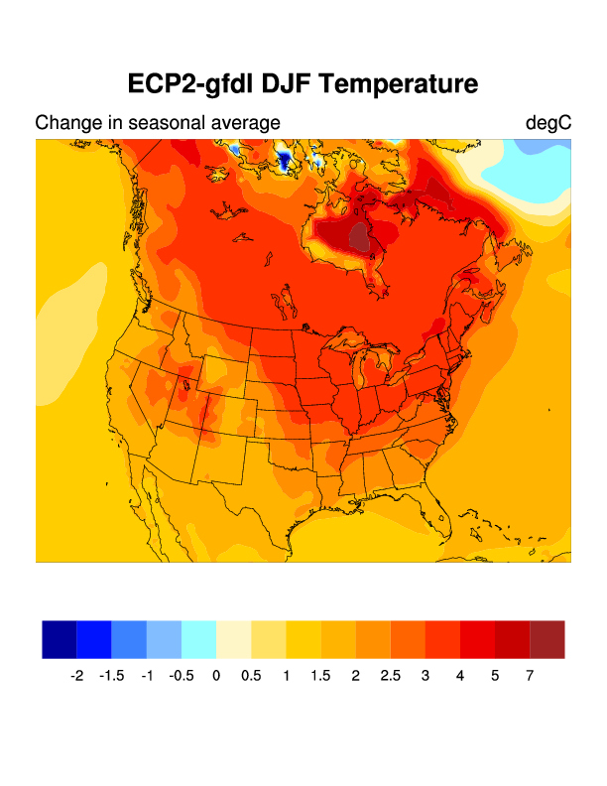
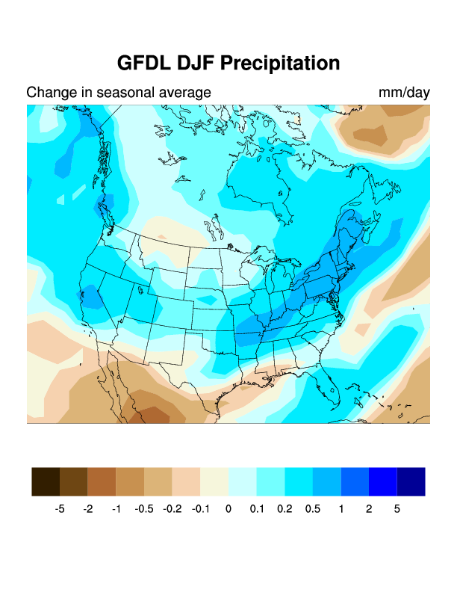
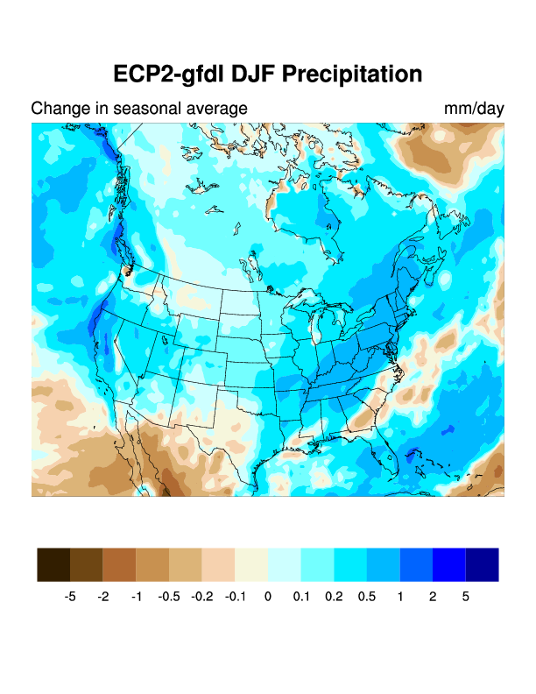
Dec-Jan-Feb
Notes:
Agreement seeing mostly in the wintertime.

Slide 12
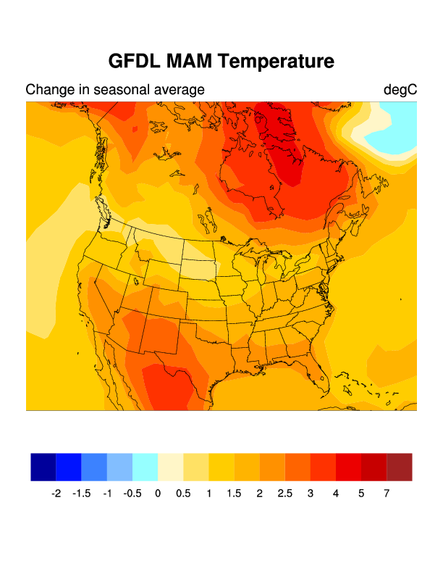
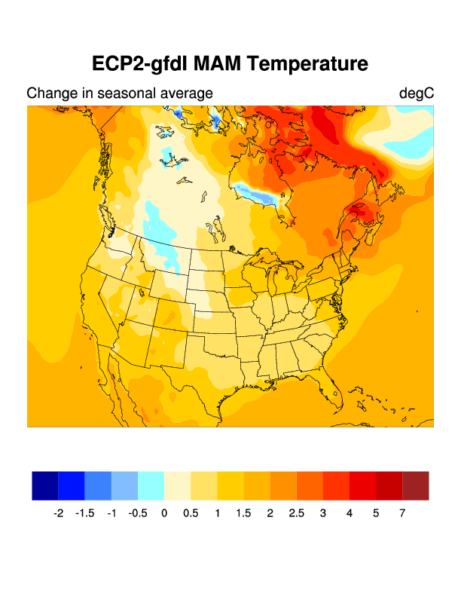
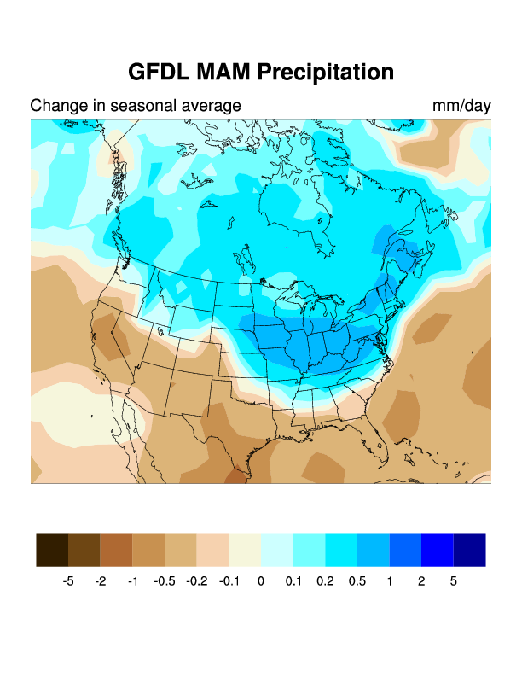
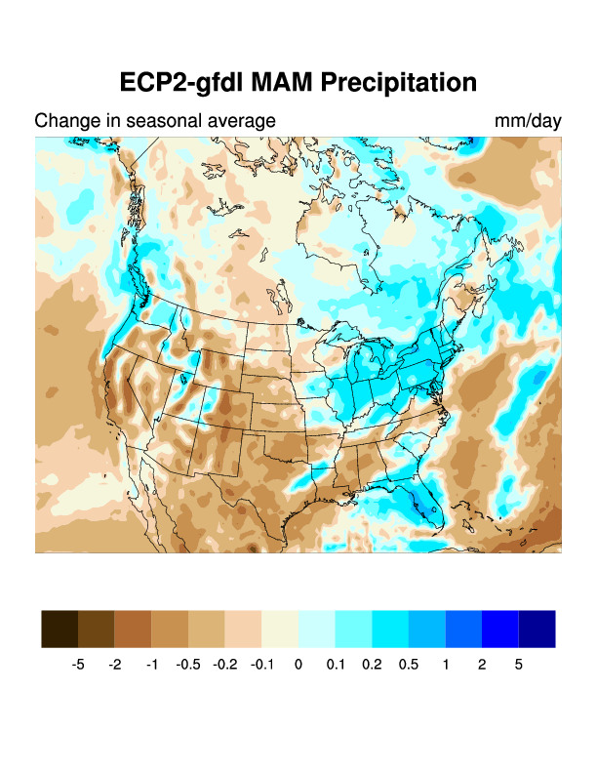
Mar-Apr-May
Notes:
Dissimilarities are more evident in spring…

Slide 13
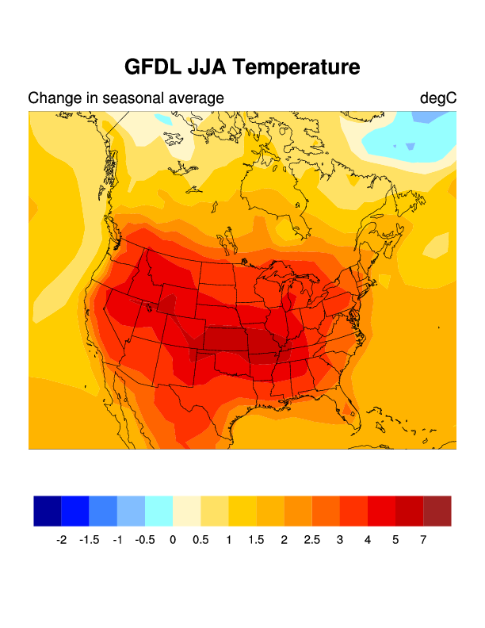
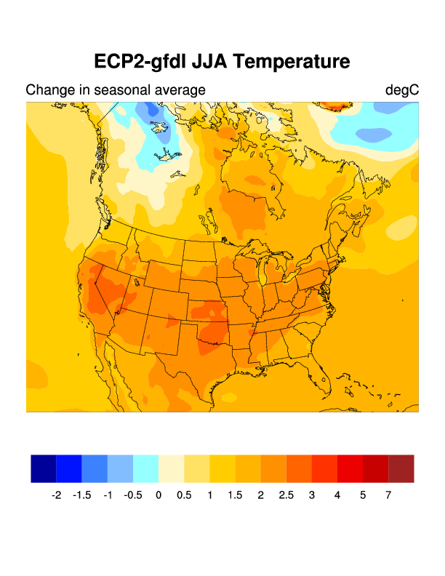
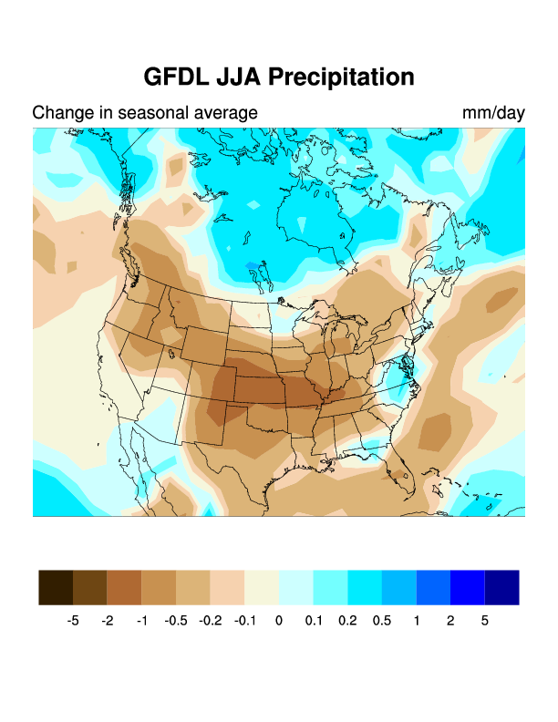
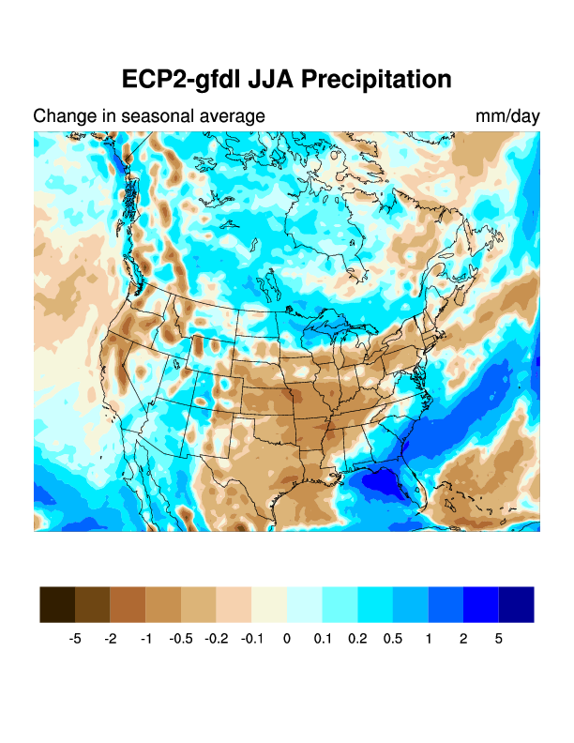
Jun-Jul-Aug
Notes:
And summer (although less).

Slide 14
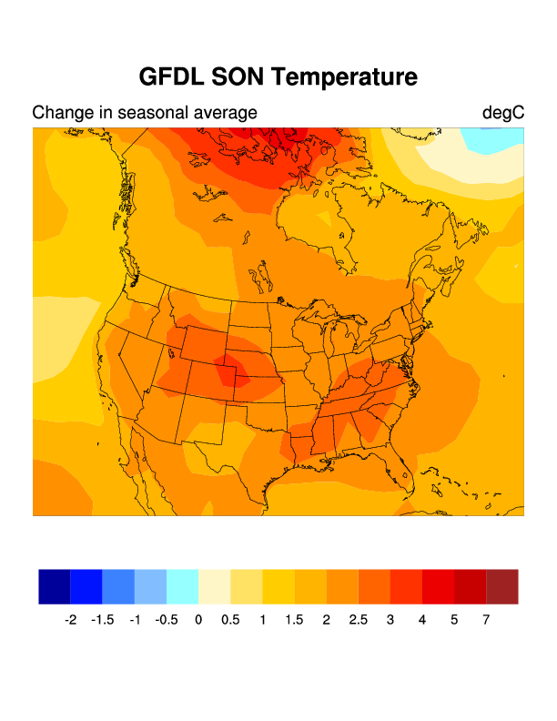
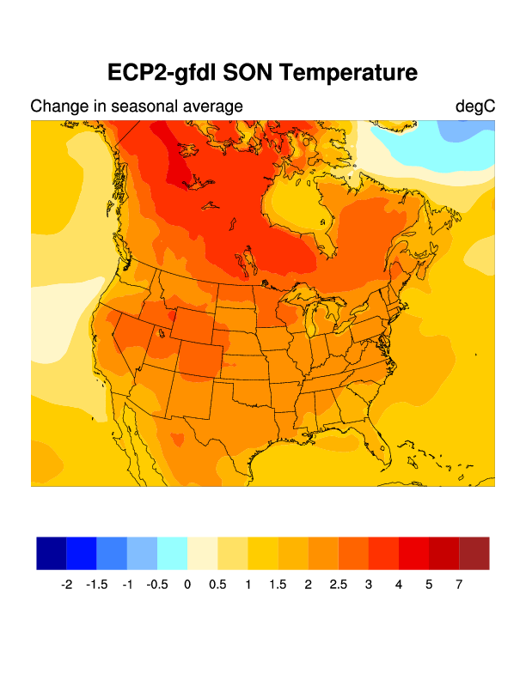
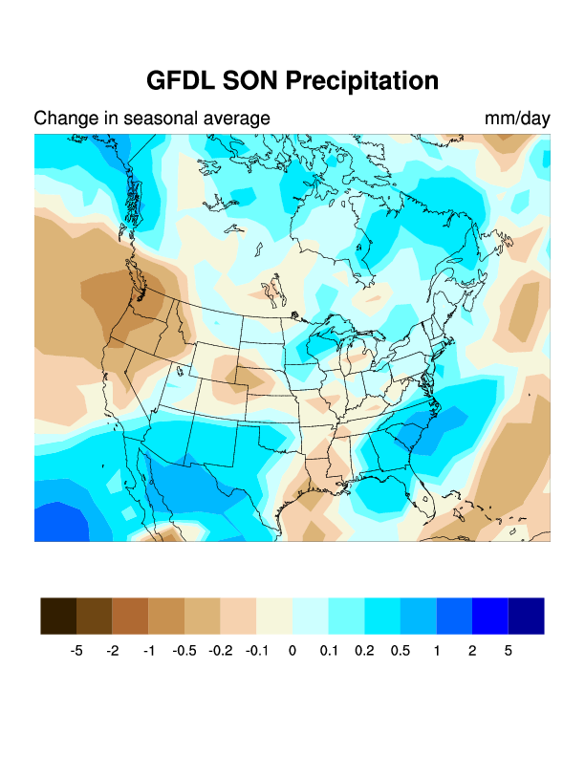
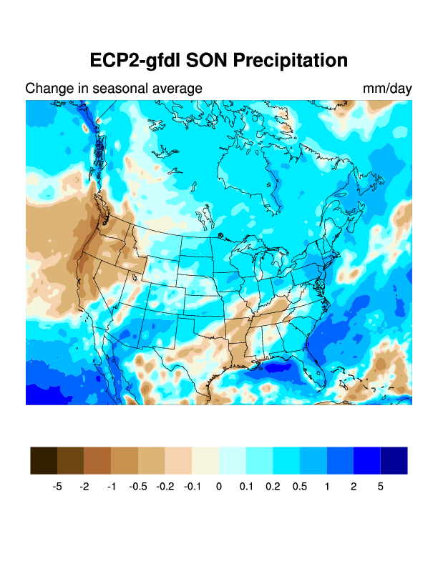
Sep-Oct-Nov
Notes:
Similar over the eastern coast.

Slide 15
Concluding Remarks
NARCCAP has provided a good insight on model uncertainty, and has shown advances in dynamical downscaling strategies (e.g., spectral nudging techniques).
Significant improvement in dynamical downscaling also involves better model coupling strategies (e.g., atmosphere-land-surface interactions).
Regarding model coupling strategies, the role of atmosphere-ocean-land coupling in dynamical downscaling of climate projections deserves attention to better address the impact of ocean forcing on coastal and continental areas

Slide 16
More specifically:
ECP2 HadCM3-driven runs will be available in a few months.
The existing ECP2 runs will be repeated with an RSM running at UFRJ.

