Slide 1

The 4th NARCCAP Users’ Meeting, April 10-11, 2012, Boulder, CO.
Development of Climate Change Projections for Prairie Hydrological and Water Quality Modeling
(funded by the Canadian Water Network)
*Hua Zhang and Gordon Huang
Institute for Energy, Environment and Sustainable Communities (IEESC)
University of Regina
Regina, Saskatchewan, Canada

Slide 2
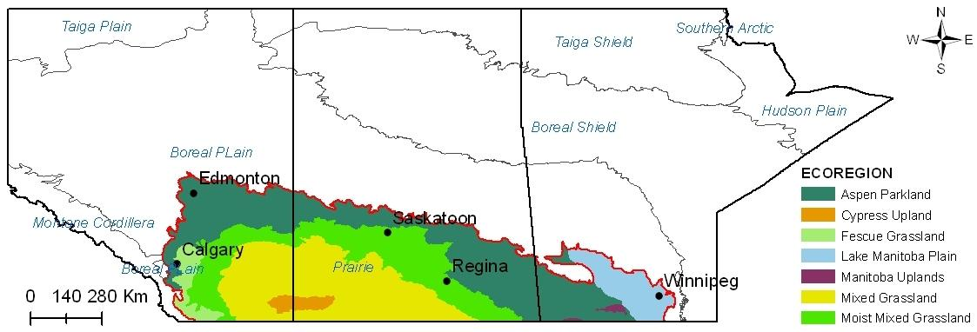
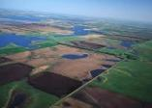
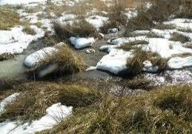
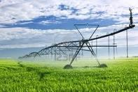
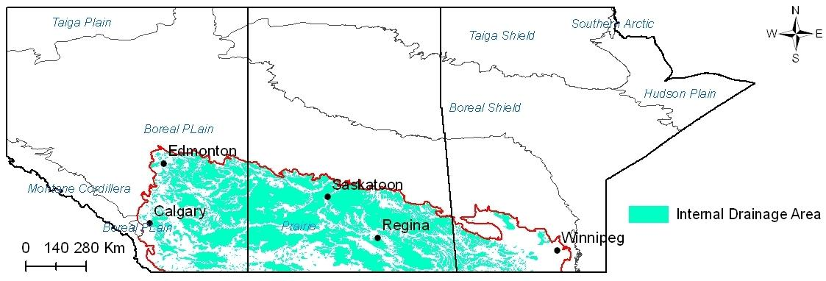
The Canadian Prairies
520,000 km²
Breadbasket
of Canada
Critical ecosystem services
<100 km²
Semi-arid climate
Snow-dominated hydrology
Agriculture
Sensitive to climate change

Slide 3

Projection of Climate Change
Trends in impacts studies in prairie region…
GCM
Single RCM
RCM ensemble
Challenge #1
How to evaluate and combine RCMs?
Different time scales
Different statistical features
Precipitation occurrence

Slide 4
Projection of Climate Change
Trends in impacts studies in prairie region…
GCM
Single RCM
RCM ensemble
Challenge #2
How to fit small prairie watersheds?
2500-km² grid vs 100-km² watershed
Statistical downscaling
Multiple weather series

Slide 5
Framework
Weighted
Ensemble
Multiple RCMs
Evaluation metrics
Weighting and projection
Coupled Downscaling
Weather
Generator
Site-scale validation/projection
Monthly shifts
Multiple weather series
Integrated Watershed Modeling
Integrated simulation system
Uncertainty analysis
Risk analysis
Watershed Simulation

Slide 6
Metrics for RCM Evaluation
M1
M2
M4
M5
M3
Metrics

Slide 7
Metrics for RCM Evaluation
Interannual circulation pattern
Variability of annual temperature (SD):
Variability of annual precipitation (CV):
Linear trend of annual temperature (regression coefficient)
Linear trend of annual precipitation (regression coefficient)
M1
M2
M4
M5
M3
Metrics

Slide 8
Metrics for RCM Evaluation
M1
M2
M4
M5
M3
Seasonal circulation pattern
Correlation of seasonal temperature
Correlation of seasonal precipitation
Interconnection of seasonal temperature and precipitation
Metrics

Slide 9
Metrics for RCM Evaluation
M1
M2
M4
M5
M3
PDFs of daily variables
Overlap of daily minimum temperature PDFs
Overlap of daily maximum temperature PDFs
Overlap of daily precipitation PDFs
(Perkins et al. 2007)
Metrics

Slide 10
Metrics for RCM Evaluation
M1
M2
M4
M5
M3
Extreme events
Metrics
99.7th of daily precipitation
0.03rd of daily minimum temperature
99.7th of daily maximum temperature

Slide 11
Metrics for RCM Evaluation
M1
M2
M4
M5
M3
Metrics
Precipitation Occurrence
Length of wet and dry spells
Occurrence of wet day (wet-wet: probability of a wet day following a wet day; wet-dry: probability of wet day following a dry day)

Slide 12
Combination of Metrics
Day | RCM1 (w=0.3) | RCM2 (w=0.4) | RCM3 (w=0.3) | ENS
D1 | 3 | 0 | 0 | 0.9
D2 | 0 | 5 | 3 | 2.9
D3 | 0 | 0 | 2 | 0.6
D4 | 3 | 4 | 0 | 2.1
Weights of RCMs:
Ensemble-based projection:
Temperature:
???
Precipitation:

Slide 13
Combination of Metrics
For example, W* = 0.5
Day | RCM1 (w=0.3) | RCM2 (w=0.3) | RCM3 (w=0.4) | ENS
D1 | 3 | 0 | 0 | 0
D2 | 0 | 5 | 3 | 2.9
D3 | 0 | 0 | 2 | 0
D4 | 3 | 4 | 0 | 2.1
Weights of RCMs:
Ensemble-based projection:
Temperature:
Precipitation:

Slide 14

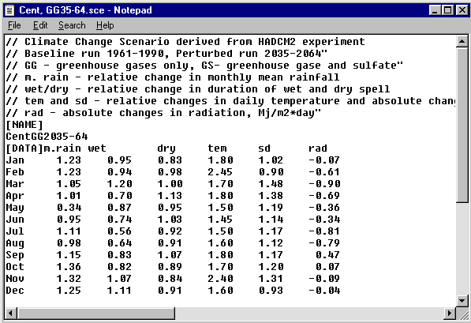
Stochastic Weather Generator (SWG)
SWG: reproduce observed climate normals, but not the actual sequences of single events
LARS-WG
Developed by Semenov and Barrow (1997)
Alternate wet/dry series by monthly semi-empirical distributions
Daily values calculated by Fourier series and normal distribution
Using monthly shifts to reflect climate change (from the ensemble)

Slide 15
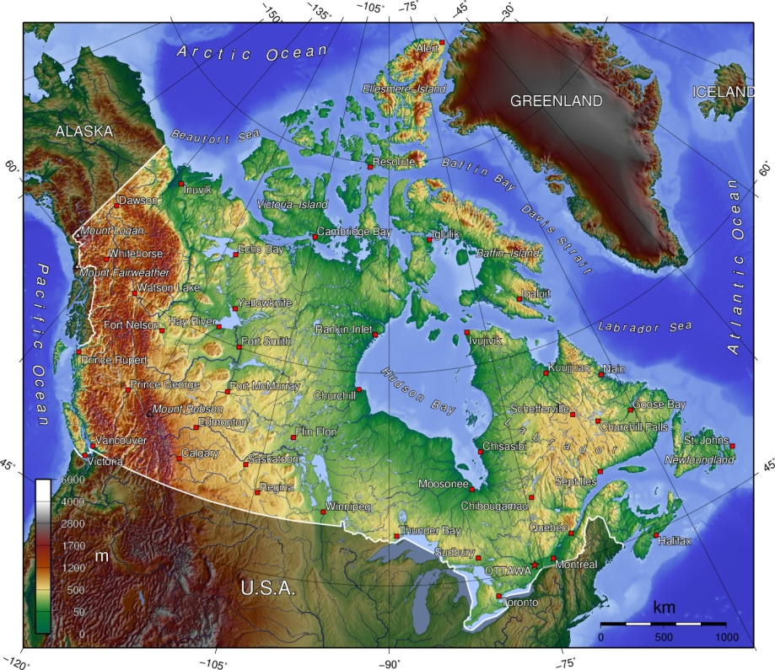
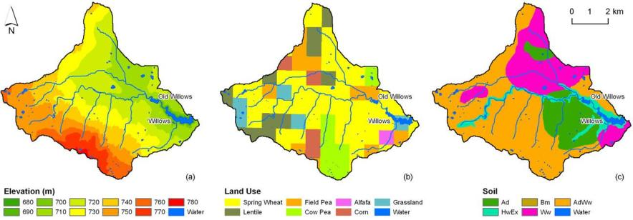
Study Area
The Assiniboia Watershed
Area: 49.7 km²
Elevation: 693 -773 m
Land use: farming
Soil: Chenozemics
Annual T: 3.9ﾟC
Annual P: 393 mm
Annual PET: 1135 mm
Old Willows
Old Willows
Old Willows
New Willows
New Willows
New Willows

Slide 16
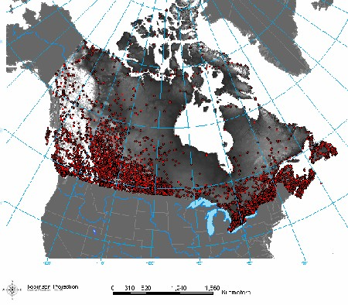
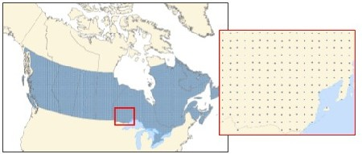
Data Collection
RCMs
CRCM, OURANOS, Canada (DAI & NARCCAP)
HRM3, Hadley Centre, UK (NARCCAP)
RCM3, UC Santa Cruz, US (NARCCAP)
WRFG, PNNL, US (NARCCAP)
Validation
Driving data: NCEP II (1974-2003)
Observation data: Canada 10-km gridded dataset (1961–2003), produced by AAFC & NRC
Projection
Baseline: 1971–2000
Future: 2041–2070 (A2)
Models: CGCM3/CRCM, HadCM3/HRM3, CCSM/WRFG, GFDL/RCM3

Slide 17
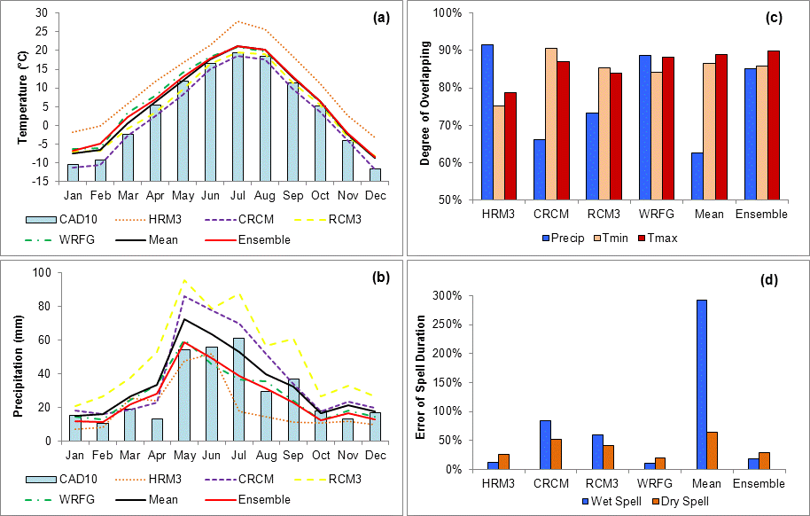
Results: Evaluation of RCMs and Ensemble

Slide 18
Projection of Climate Change (by ensemble)
Climate Change Predicted
Month | T_{min}* | T_{max}* | T_{std}** | Precip** | Wet Spell** | Dry Spell**
Jan | 4.91 | 3.88 | 0.15 | 0.36 | 0.27 | -0.27
Feb | 2.66 | 2.06 | -0.06 | 0.24 | -0.05 | -0.09
Mar | 2.32 | 2.15 | -0.20 | -0.15 | 0.09 | 0.23
Apr | 2.31 | 2.58 | -0.35 | 0.22 | 0.00 | -0.04
May | 1.90 | 1.40 | -0.38 | 0.20 | 0.21 | 0.01
Jun | 3.29 | 1.69 | -0.08 | -0.01 | -0.04 | 0.28
Jul | 3.66 | 1.73 | -0.20 | 0.03 | -0.07 | -0.17
Aug | 4.04 | 1.30 | 0.01 | 0.79 | 0.04 | -0.19
Sep | 3.09 | 2.88 | -0.26 | -0.29 | -0.11 | 0.02
Oct | 2.88 | 2.60 | -0.25 | -0.08 | 0.02 | 0.01
Nov | 3.47 | 3.12 | 0.27 | -0.24 | -0.01 | 0.26
Dec | 2.36 | 1.53 | 0.02 | -0.04 | -0.04 | 0.13
Annual | 3.07 | 2.24 | -0.11 | 0.09 | 0.03 | 0.01
Note: * absolute change; ** relative change.

Slide 19
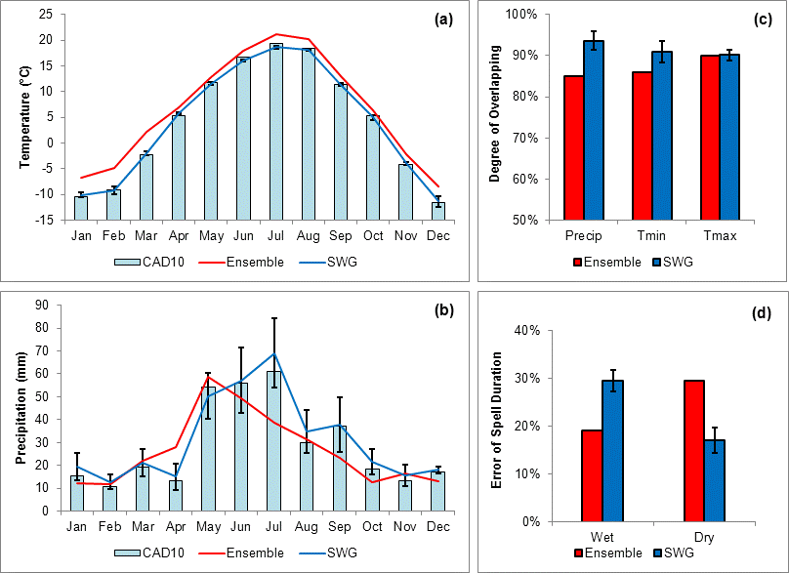
Results: Validation of LARS-WG
Climate Change Predicted

Slide 20
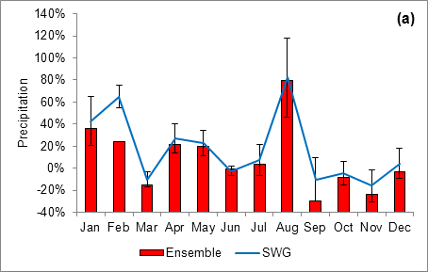
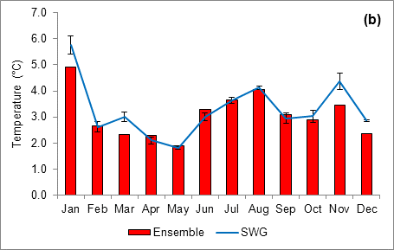
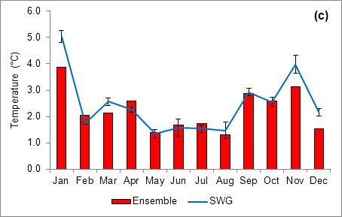
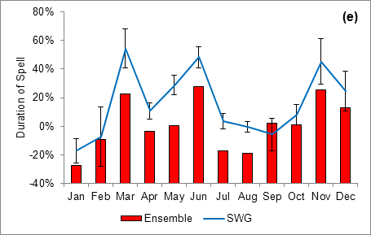
Results: Projection of Climate Change
Climate Change Predicted

Slide 21

Discussion
RCM performance
Warm bias in winter temperature
Dry bias in summer rainfall
Misinterpretation of prairie landscape (small wetlands)
Further improvement
Weighting scheme (threshold of precipitation occurrence; multicriteria assessment)
Sample size (models and scenarios)
Multi-site weather generator

Slide 22
Multi-level Watershed-reservoir Modeling System (MWRMS)
Meteorological data (Tmp, Wind, Hum, Rad, Precip, Cloud, etc.)
Water Use
Overland
Flow (Q, T)
Hydrodynamic Model
Watershed Model
Hydrodynamic module
Thermal module
Lateral
Flow (Q, T)
Hydrological module
Vel, Depth
Water T
Channel
Flow (Q, T)
Eutrophication Model
Biochemical module
Point Loading (N, P, DO, BOD)
N Cycle
Phyto.
Kinetics
Diffusive Loading (N, P, DO, BOD)
P Cycle
DO
Balance
Surface data (topography, bathymetry, soil, land use, etc.)

Slide 23
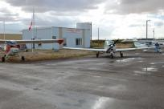
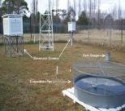
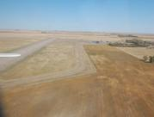
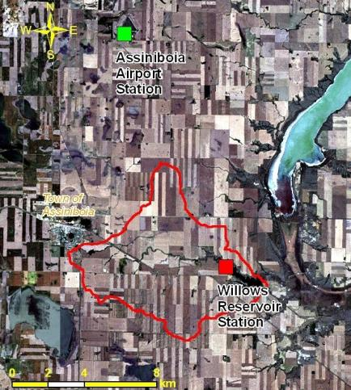
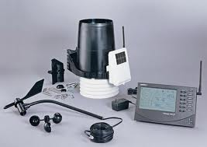
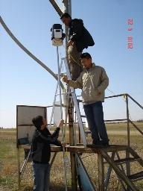
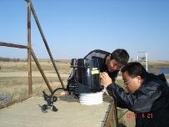
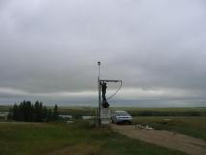
Metereological Data
1960-2010
49.73° N, 105.95° W, STN# 4020286
2009-2010
Temperature, precipitation,
wind direction & speed, humidity, radiation, pressure
(Daily or 30-min)
49.61° N, 105.87° W, Vantage Pro2-6162

Slide 24
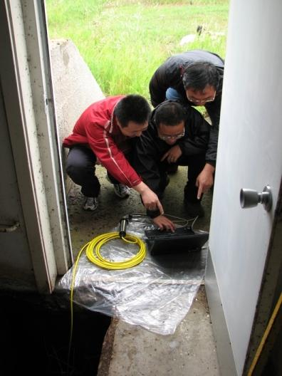
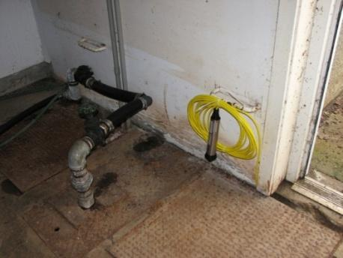
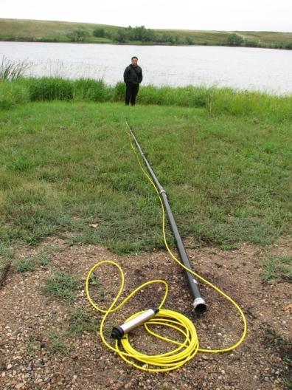
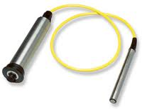
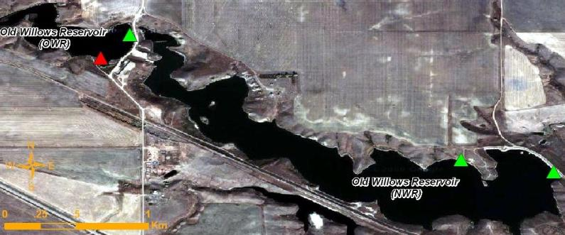
Hydrolocial Data
Automatic water logger (WL16)
Water level & temperature (30-min)
2009 - 2011
Assiniboia water plant station: weekly water level, 1978 - 2010
PFRA station: daily inflow rate, 1976 – 2003

Slide 25
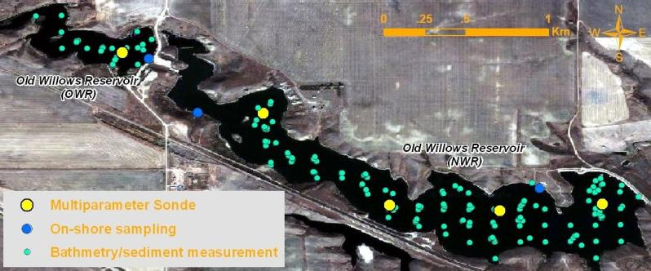
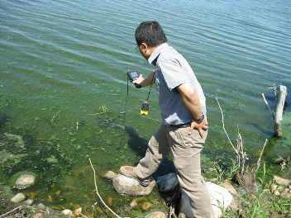
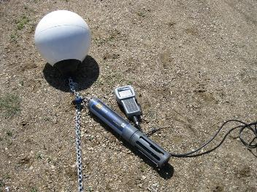
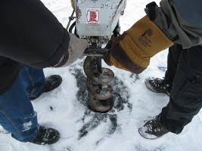
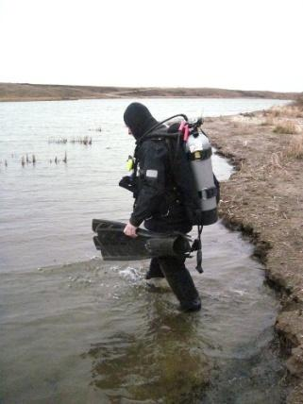
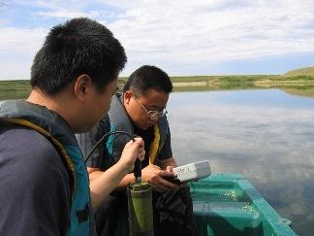
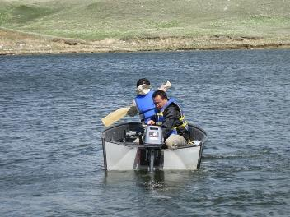
Water Quality Data
Automatic monitoring
DO, turbidity, BGA, Chlα, pH, temperature, water depth
per 30-min, 2009 – 2010
Sampling & lab analysis
NO₃-N, NH₄-N, TKN, SP, TP, BOD, Chlα, Ortho-P
wkly/mthly, 2008 – 2010

Slide 26
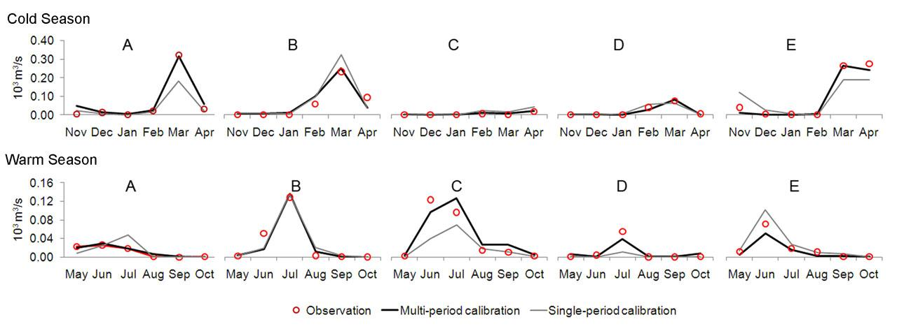
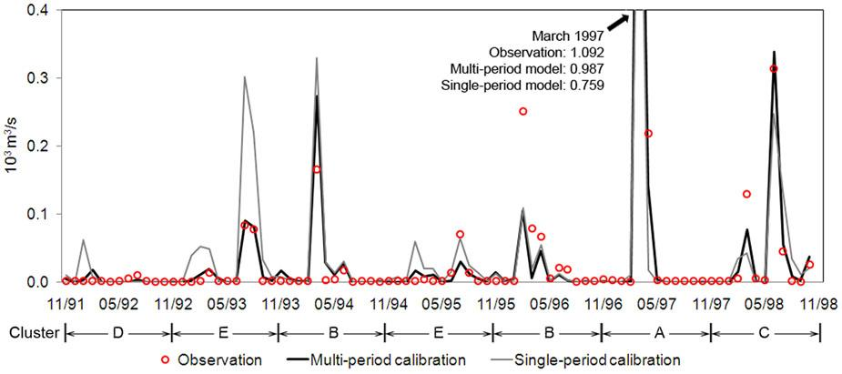
Calibration Results: Watershed Hydrology
Calibration
Validation
Calibration:
NS = 0.83
PBIAS = 0.41
Validation:
NS =0.95
PBIAS = 10.83

Slide 27
Calibration Results: Reservoir Water Quality
Site: OWR-S5
Depth: 0.5 m
Time: 2009 – 2010
Simulation
Observation

Slide 28
Hydrological Response to Climate Change ChangeHydrometeorological Changes
Less snow; increased ET; decreased water yield
Snow/Total P
ET/PET
ET
Water Yield

Slide 29
Biogeochemical Responses to Climate Change
More nutrient loss; degraded water quality (eutrophication)

Slide 30
Related Publications
Climate Change Predicted
Published:
Zhang, H., Huang, G.H., Wang, D.L., et al.. An integrated multi-level watershed-reservoir modeling system for examining hydrological and biogeochemical processes in small prairie watersheds. Water Research, 46(4): 1207-1224.
Zhang, H. and Huang, G.H. (2009). Building channel networks for flat regions in digital elevation models. Hydrological Processes, 23(20): 2879-2887.
Zhang, H., Huang, G.H., Wang, D.L. and Zhang, X.D. (2011). Uncertainty assessment of climate change impacts on the hydrology of small prairie wetlands. Journal of Hydrology, 396(1-2): 94-103.
Zhang, H., Huang, G.H., Wang, D.L. and Zhang, X.D. (2011). Multi-period calibration of a semi-distributed hydrological model based on hydroclimatic clustering. Advances in Water Resources, 34: 1293-1303.
Under Review:
Zhang, H. and Huang, G.H. Development of climate change projections for small prairie watersheds using a weighted multi-RCM ensemble and a stochastic weather generator. Climate Dynamics.
Zhang, H. and Huang, G.H. An integrated stochastic-fuzzy modeling approach for risk assessment of soil water deficit and reservoir water quality degradation under climate change. Science of the Total Environment.

Slide 31

Summary
Coupled downscaling: Ensemble + SWG
Enhanced confidence
Increased resolution
Improved efficiency
Better connection with watershed hydrological and biogeochemical modeling
Better support for impact studies in small prairie watersheds

Slide 32
Recommendations to NARCCAP
Climate Change Predicted
Distribute biweekly or monthly newsletters
Provide online training courses for data analysis and management
Organize online meetings (skype) for small group discussions

Slide 33
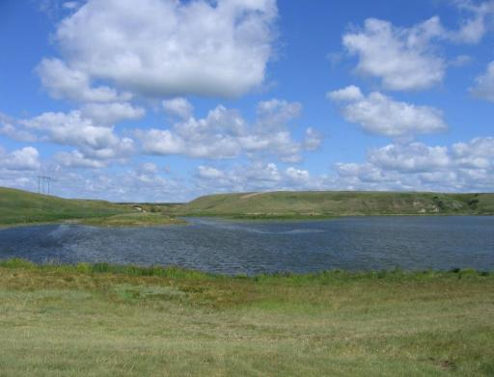
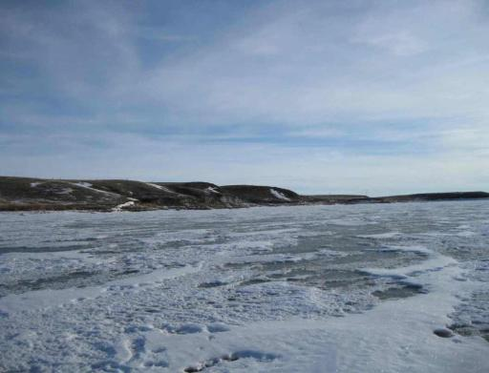
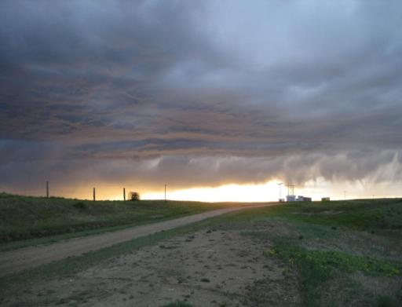
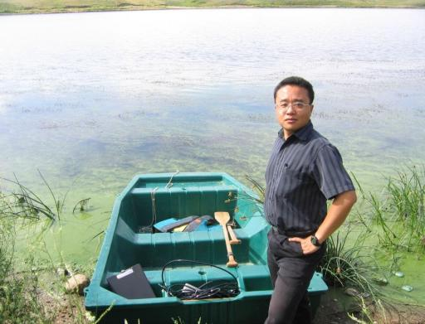
Thank You Very Much
Notes:
That’s all. Thank you very much!

