Slide 1
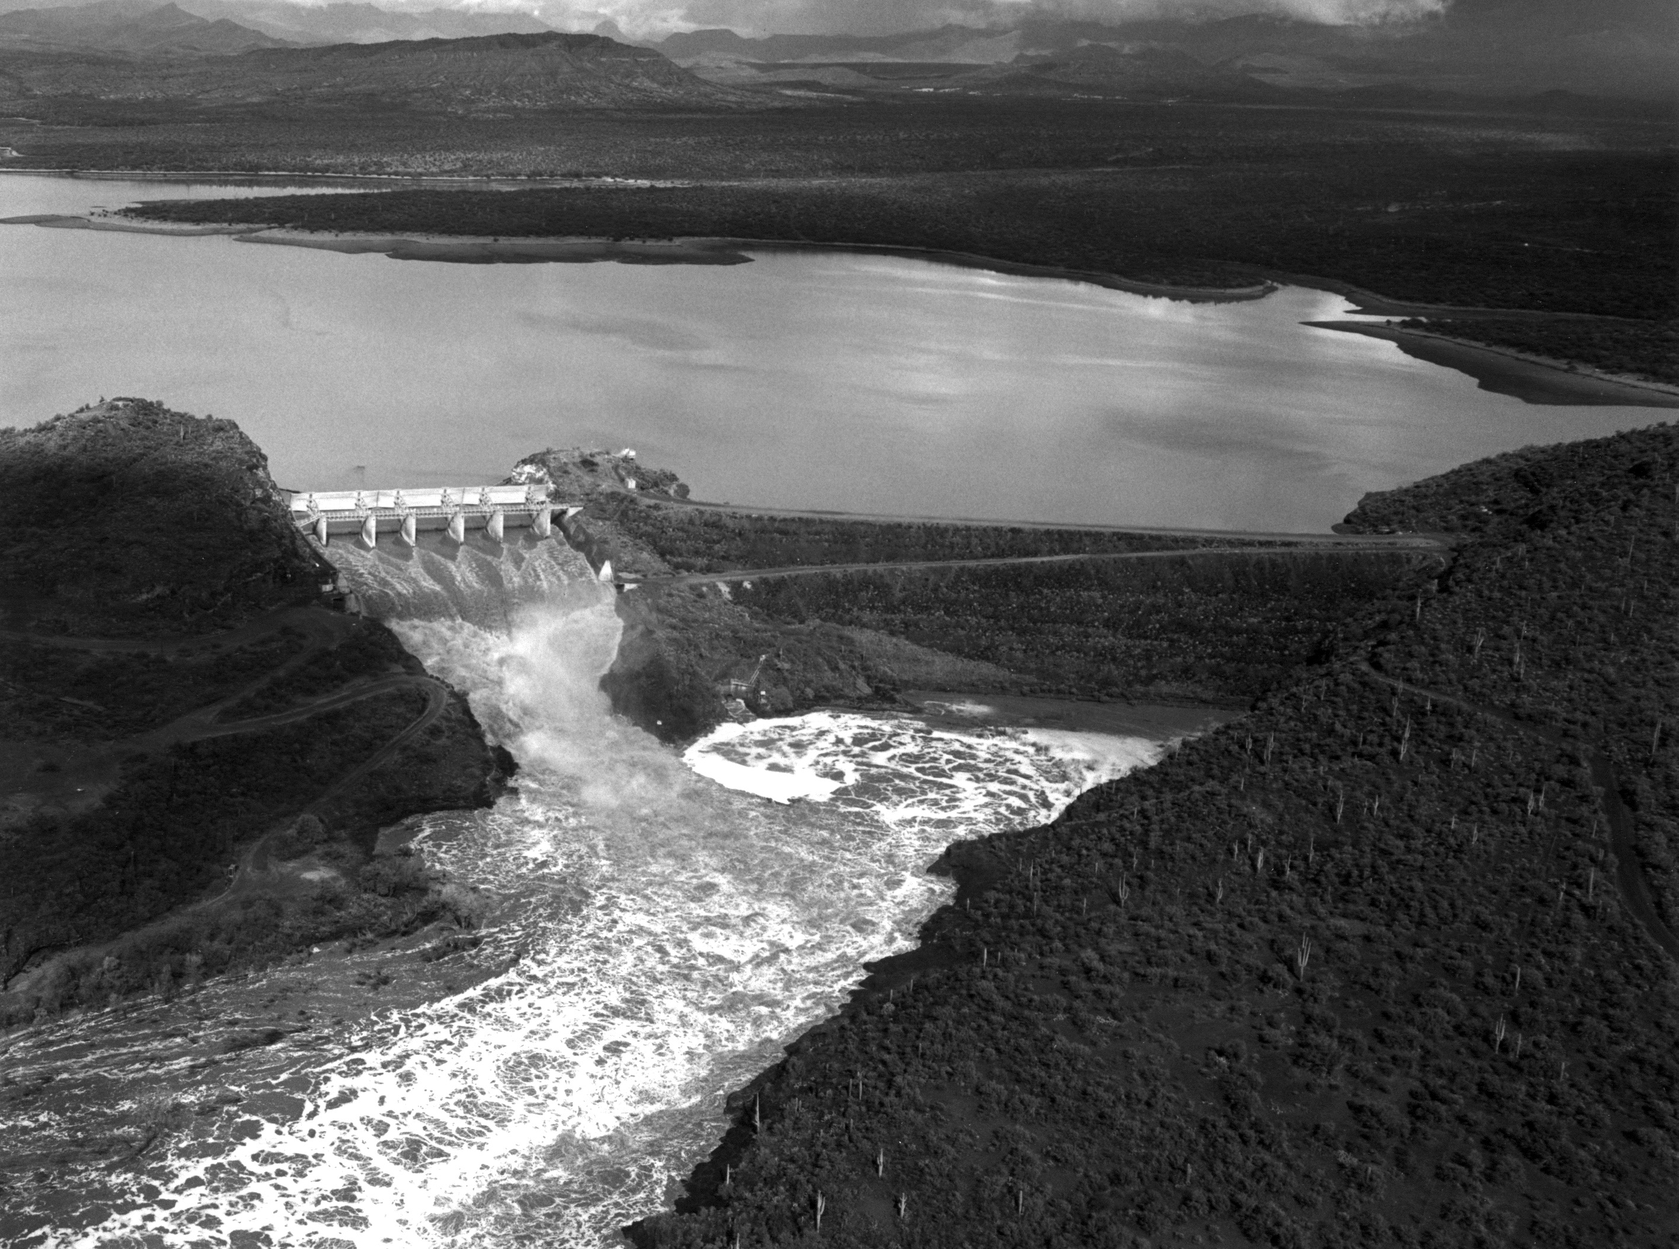
Changes in winter precipitation extremes for the Western United States
Horseshoe Reservoir AZ, Feb. 1993
Francina Dominguez
Assistant Professor
Atmospheric Sciences
University of Arizona
Erick Rivera
Atmospheric Sciences
University of Arizona
Provided by Phil Pearthree and Ann Youberg
AZ Geological Survey

Slide 2
1) Model Projections of Changes in Extreme Winter Precipitation
2) Physical Mechanisms causing changes in Extreme Winter Precipitation
Horseshoe Reservoir AZ, Feb. 1993
Provided by Phil Pearthree and Ann Youberg
AZ Geological Survey

Slide 3
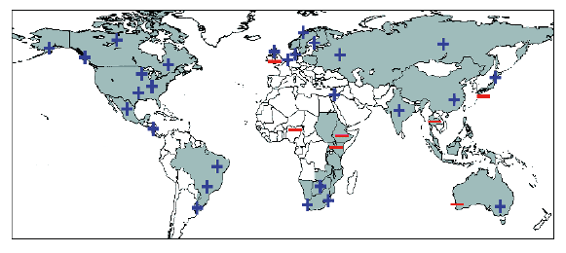
Can regional climate models reproduce historical extreme events, over the Western US?
Can they provide useful information about future hydrologic conditions under increased greenhouse gas forcing conditions?
Regions where disproportionate changes in heavy and very heavy precipitation during the past decades were documented as either an increase (+) or decrese (-) compared to the change in the annual and/or seasonal precipitation (updated from Groisman et al, 2005), taken from Trenberth et al. (2007)
DOE-funded project: Hydrologic Extremes in a changing climate: how much information can regional climate models provide?
PIs: F. Dominguez, D. Lettenmaier, C. Castro
12

Slide 4
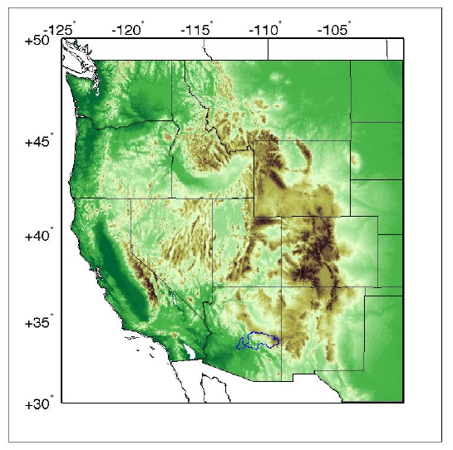
We use eight different regional climate model simulations (NARCCAP + UofA) over the Western US.
Global Climate Models
Regional Climate Models
Dominguez et al., 2012. Geophys. Res. Lett.

Slide 5
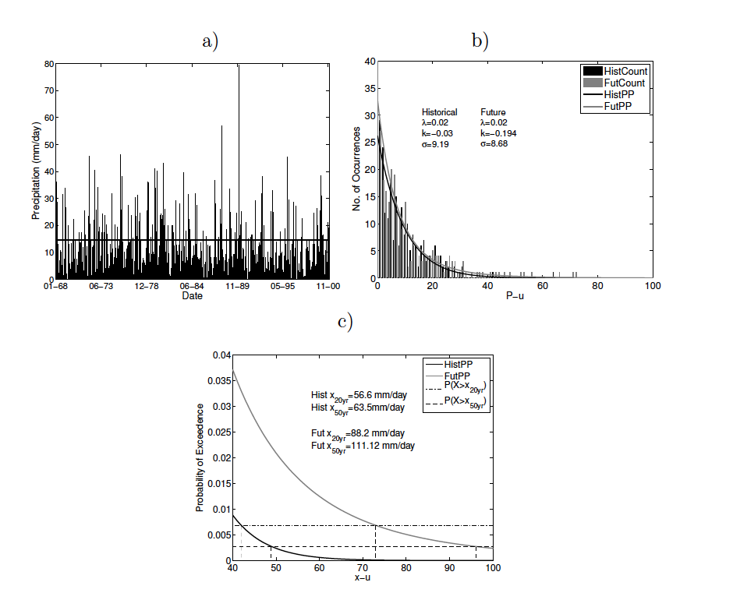
We use a ‘‘Poisson–GP model’’ to characterize the statistical distribution of extreme events. (Katz et al. 1999, 2002, 2010).
We don’t use GEV theory because it is limited to block maxima.
Historical
Future
Historical
Future
Poisson process models the occurrence. Generalized Pareto (GP) models the excess over the threshold.
Example Salt River Basin, AZ
Dominguez et al., 2012. Geophys. Res. Lett.

Slide 6
The models realistically represent the spatial distribution of mean and extreme precipitation (1979-2000 period)
All models have a positive bias in the mean.
Mean Winter Precipitation
mm/day
0 1 2 3 4 5
Observations
Assimilated Observations
Eight Model Ensemble
Dominguez et al., 2012. Geophys. Res. Lett.

Slide 7
The models realistically represent the spatial distribution of mean and extreme precipitation (1979-2000 period)
All models have a positive bias in the mean.
Mean Winter Precipitation
mm/day
0 1 2 3 4 5
50-yr Return Period Winter Precipitation
All models have a positive bias in the extremes.
mm/day
0 20 40 60 80
Dominguez et al., 2012. Geophys. Res. Lett.

Slide 8
Mean winter precipitation is projected to increase in the north and decrease in the south and west.
Mean Winter Precipitation
Ensemble change of models that pass significance t-test.
Dominguez et al., 2012. Geophys. Res. Lett.

Slide 9
Mean winter precipitation is projected to increase in the north and decrease in the south and west.
Mean Winter Precipitation
Extreme precipitation is projected to increase throughout the domain.
50-yr Return Period Winter Precipitation
Bootstrappng significance test.
Dominguez et al., 2012. Geophys. Res. Lett.

Slide 10
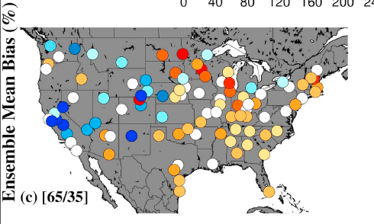
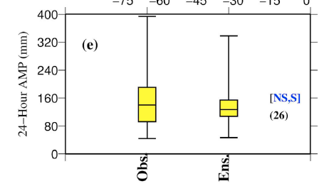
However, 24-hour 100-year events behave very differently than 3-hour 100-year events.
Bias for 24-hour 100-year return period events.
Ensemble mean bias +-10%
Bias has a clear geographical pattern, For Annual Maximum, 26% are acceptable for design.
Mishra, V., Dominguez, F. and Lettenmaier, D., 2012. Geophys. Res. Lett.

Slide 11
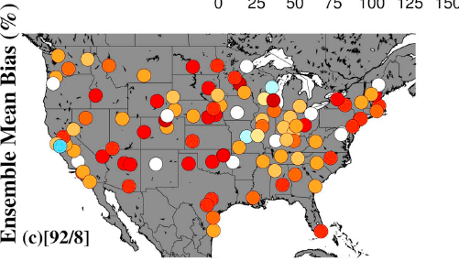
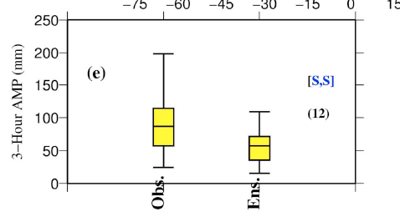
However, 24-hour 100-year events behave very differently than 3-hour 100-year events.
Bias for 24-hour 100-year return period events.
Bias for 3-hour 100-year return period events.
Bias has a clear geographical pattern, 26% are acceptable for design.
Generalized underestimation and 12% acceptable for design purposes.
Mishra, V., Dominguez, F. and Lettenmaier, D., 2012. Geophys. Res. Lett.

Slide 12
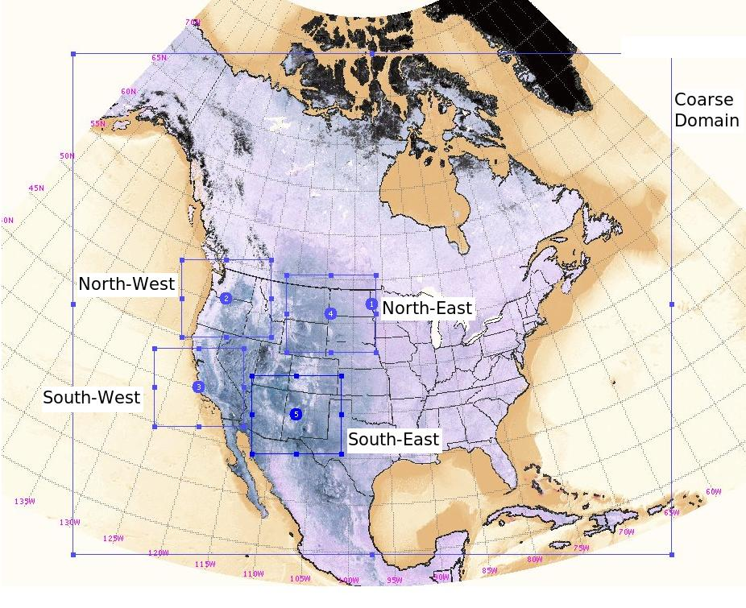
Future: We are evaluating the effect of model resolution on the representation of extreme events.
50 km resolution
3-hrly
10 km resolution
1-hrly
Use NCEP/DOE Reanalysis II data as boundary conditions (with spectral nudging). Period 1979-2010.
Tripathi, O. and F. Dominguez In Preparation

Slide 13
Future: We are evaluating the effect of model resolution on the representation of extreme events.
% Hits 24-hourly accumulated precipitation 10km.
We find that the 10km runs more adequately capture the intensity of extreme events.
We find that the 10km runs also have a higher “hit/miss” ratio than the 50km runs.
% Hits 24-hourly accumulated precipitation 50km.
Tripathi, O. and F. Dominguez In Preparation

Slide 14
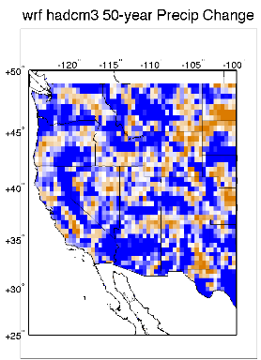
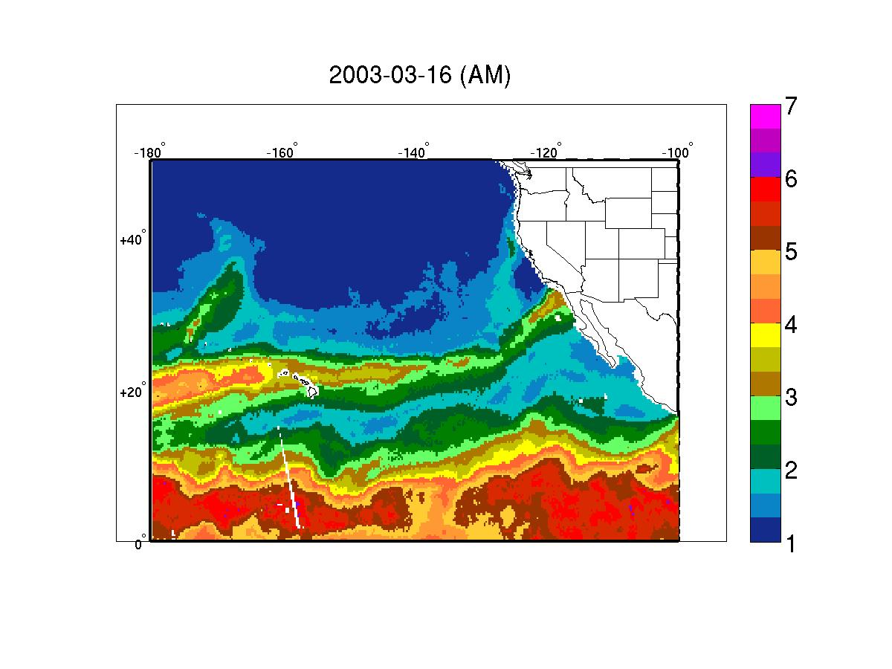
Future: We are studying the physical mechanisms that could lead to the intensification of extreme events.
UofA model
Extreme Precip Change
Atmospheric Rivers
cm
?
AR
Integrated water vapor (IWV)
The Special Sensor Microwave/Imager (SSM/I)
Mogollon Rim
Rivera, E. and F. Dominguez In Preparation

Slide 15
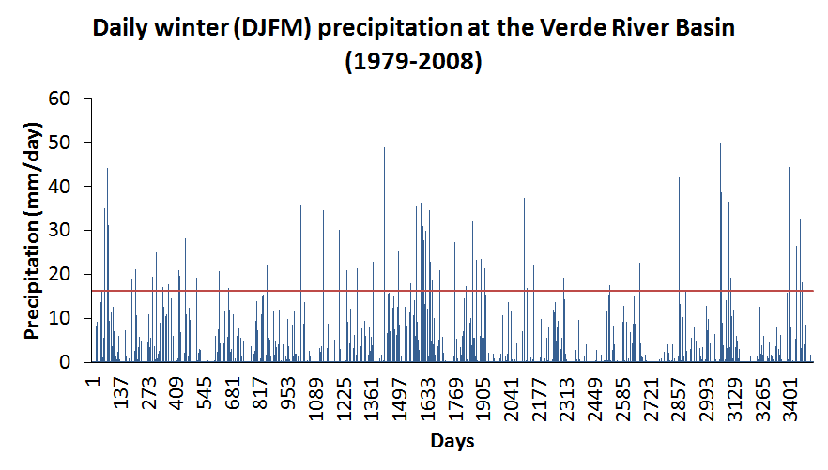
For the Verde River Basin, we used NARR precipitation data to obtain a list of events that exceeded a high threshold.
Daily winter (DJFM) precipitation at the Verde River Basin
(1979-2010)
98th percentile
Mogollon Rim
VRB
We identified the most important spatial patterns of integrated water vapor transport (IVT) associated to these extreme events.
Rivera, E. and F. Dominguez In Preparation

Slide 16
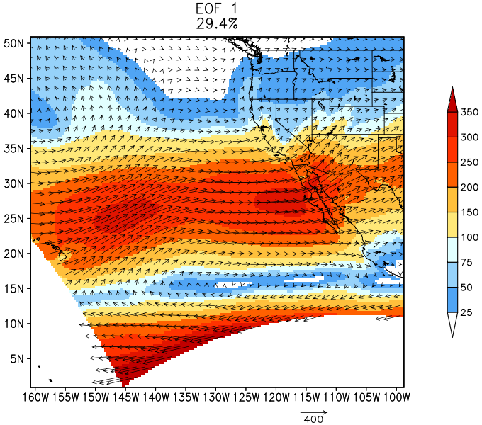
The most dominant pattern shows the characteristic water vapor transport/corridor associated with ARs
1st Pattern of Integrated Water Vapor
Explained variance: 29.4%
SSM/I water vapor
cm
kg m⁻¹ s⁻¹
EOF 1
The Special Sensor Microwave/Imager (SSM/I) is located on the DoD satellites
Rivera, E. and F. Dominguez In Preparation

Slide 17
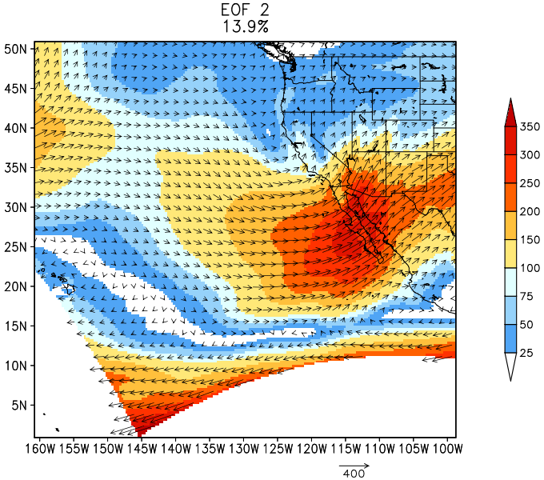
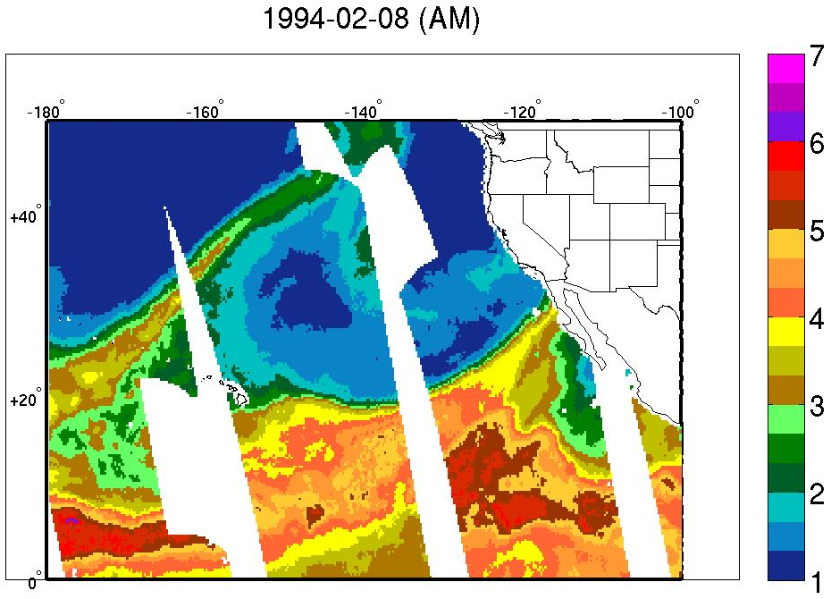
The second pattern of the integrated water vapor transport shows meridional oriented ARs
2nd Pattern of Integrated Water Vapor
Explained variance: 13.9%
SSM/I water vapor
cm
kg m⁻¹ s⁻¹
EOF 2
Rivera, E. and F. Dominguez In Preparation

Slide 18
RCM simulations show a consistent and statistically significant increase in extreme events in the Western US.
RCMs still have problems simulating sub-daily timescale events.
We are currently investigating the physical mechanisms and the effects of spatial scale on these projections.
Horseshoe Reservoir AZ, Feb. 1993
Provided by Phil Pearthree and Ann Youberg
AZ Geological Survey

Slide 19
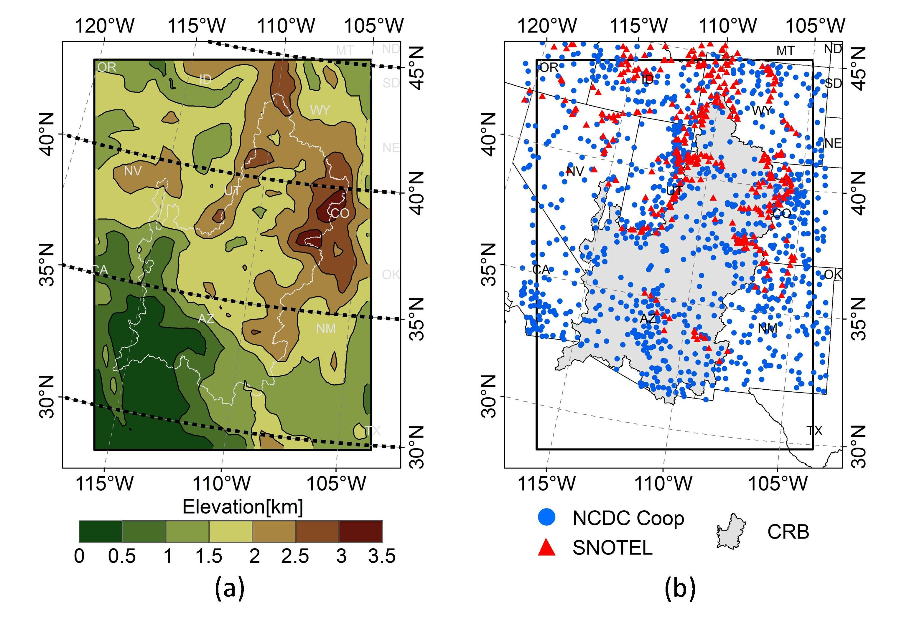
We are comparing our WRF-HadCM3 simulation with observations throughout the Colorado River Basin.

Slide 20
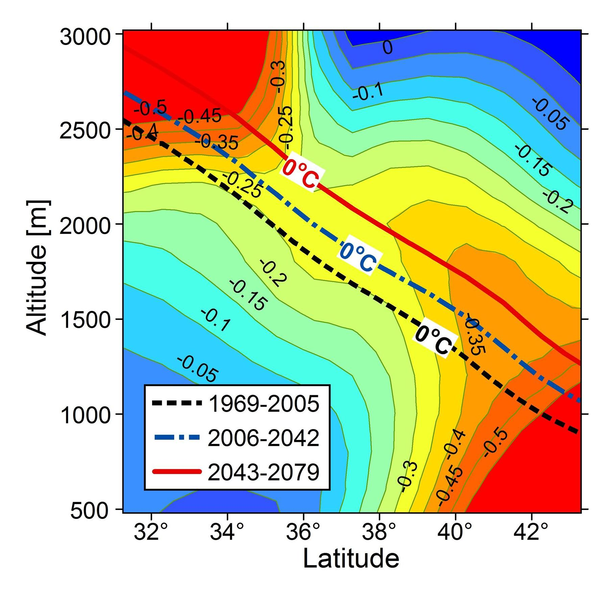
The regions of strongest declines in snowfall roughly correspond to the region of migration of the zero degree Celsius line.

Slide 21
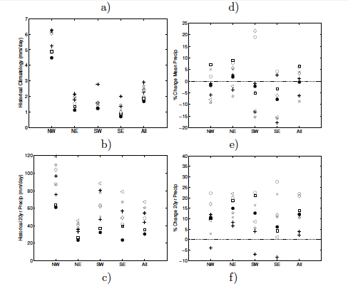

Slide 22
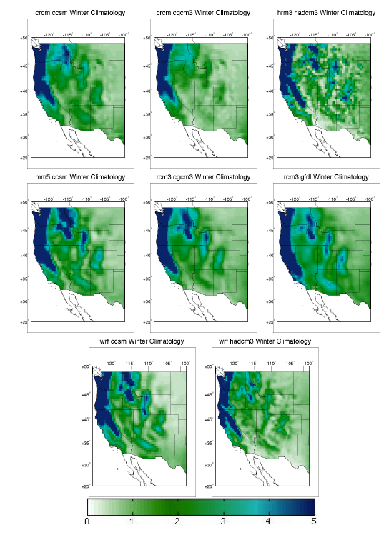

Slide 23
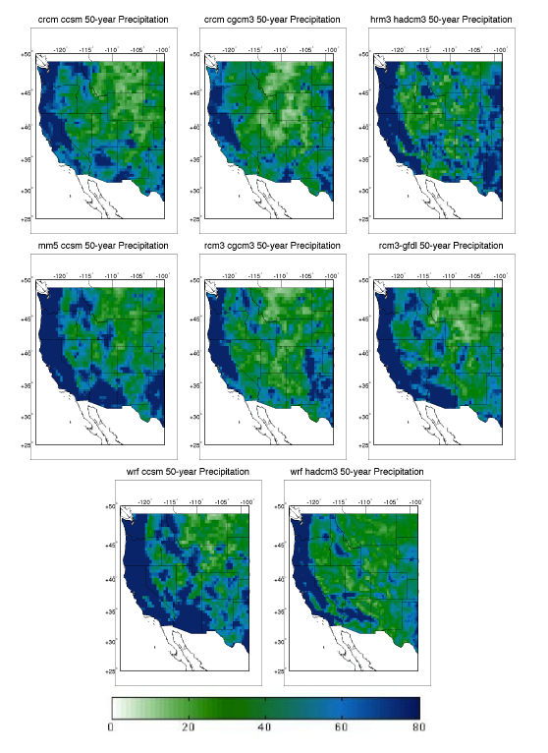

Slide 24
